Slide 1

Reporting and Analyzing Long-Term Liabilities
10
Chapter
UAA – ACCT 201 Principles of Financial Accounting Dr. Fred Barbee

Slide 2

IS FUN!
ACCT 201
Chapter 10
Day Two

Slide 3
Chapter 10 - Day 2 - Agenda
Topic | LO | Read | HW
Bond Issuances | P1, P2, P3 | 425-436 | E1,2,3,4,5,6; P1
Bond Retirements | P4 | 436-438 | E7, P5
Long-Term Notes Payable | C2, P5 | 438-442 | E12, 13
Decision Analysis | A2, A3 | 442-443 | QS10, 11, E14
HW #9: P10-1B Due Today

Slide 4
Bond Pricing Using Present Value
Bond

Slide 5


Semiannual Interest Payment
$xxxxx
Present value of an annuity of “n” payments of $1 @ “i” %.
X Factor
Present Value of Interest Payments
$xxxxx
Maturity Value of Bonds
$xxxxxxx
Present Value of $1 received “n” periods in the future, Discounted @ “i” %.
X Factor
Present Value of Principal Amount
$xxxxx
Issue Price of Bonds (Total Present Value)
$xxxxxx

Slide 6
Bonds Issued at Par (Face Value)
Bond

Slide 7
Issuing Bonds at Par
Par Value = $1,000,000
Stated Interest Rate = 10%
Market Rate = 10%
Interest Dates = 6/30 & 12/31
Bond Date = Jan. 1, 2002
Maturity Date = Dec. 31, 2021 (20 years)
Notes:
11

Slide 8
Market Rate = Contract Rate
Issuing Bonds Payable
Effective
Coupon
Market
Contract
Yield
Nominal
12%
12%
Face Value
Bonds will sell at
ACCT 201 ACCT 201 ACCT 201
Notes:
Bonds Issued at a Premium
Why??
Because the company is promising to pay a higher rate than the investors are seeking at the time.

Slide 9
Semiannual Interest Payment
$50,000
Present value of an annuity of 40 payments of $1 @ 5%
X 17.1591
Present Value of Interest Payments
$857,955
Maturity Value of Bonds
$1,000,000
Present Value of $1 received 40 periods in the future, Discounted @ 5%.
X 0.1420
Present Value of Principal Amount
$142,000
Issue Price of Bonds (Total Present Value)
$999,955

Slide 10
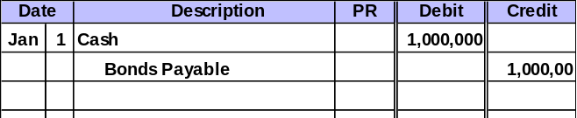
Journal Entry
Bonds Issued at Par

Slide 11
Bonds Issued at a Discount
Bond

Slide 12

Issuing Bonds at a Discount
Par Value = $1,000,000
Stated Interest Rate = 10%
Market Rate = 12%
Interest Dates = 6/30 & 12/31
Bond Date = Jan. 1, 2002
Maturity Date = Dec. 31, 2021 (20 years)
Notes:
11

Slide 13
Market Rate > Contract Rate
Issuing Bonds Payable
Effective
Coupon
Market
Contract
Yield
Nominal
16%
12%
Discount
Bonds will sell at a
ACCT 201 ACCT 201 ACCT 201
Notes:
Bonds Issued at a Premium
Why??
Because the company is promising to pay a higher rate than the investors are seeking at the time.

Slide 14
Semiannual Interest Payment
$50,000
Present value of an annuity of 40 payments of $1 @ 6%
X 15.0463
Present Value of Interest Payments
$752,315
Maturity Value of Bonds
$1,000,000
Present Value of $1 received 40 periods in the future, Discounted @ 6%.
X 0.0972
Present Value of Principal Amount
$97,200
Issue Price of Bonds (Total Present Value)
$849,515

Slide 15
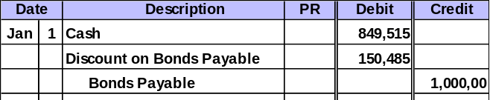
Journal Entry
Bonds Issued at a Discount

Slide 16
Bonds Issued at a Premium
Bond

Slide 17
Issuing Bonds at a Premium
Par Value = $1,000,000
Stated Interest Rate = 10%
Market Rate = 8%
Interest Dates = 6/30 & 12/31
Bond Date = Jan. 1, 2002
Maturity Date = Dec. 31, 2021 (20 years)
Notes:
11

Slide 18
Market Rate < Contract Rate
Issuing Bonds Payable
Effective
Coupon
Market
Contract
Yield
Nominal
10%
12%
Premium
Bonds will sell at
ACCT 201 ACCT 201 ACCT 201
Notes:
Bonds Issued at a Premium
Why??
Because the company is promising to pay a higher rate than the investors are seeking at the time.

Slide 19
Semiannual Interest Payment
$50,000
Present value of an annuity of 40 payments of $1 @ 4%
X 19.7928
Present Value of Interest Payments
$989,640
Maturity Value of Bonds
$1,000,000
Present Value of $1 received 40 periods in the future, Discounted @ 4%.
X 0.2083
Present Value of Principal Amount
$208,300
Issue Price of Bonds (Total Present Value)
$1,197,940

Slide 20
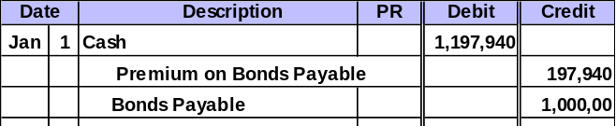
Journal Entry
Bonds Issued at a Premium

Slide 21
Bond Retirement
Bond

Slide 22
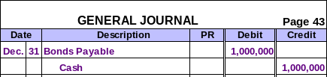
Bond Retirement
At Maturity
Before Maturity
    Carrying Value > Retirement Price = Gain
    Carrying Value < Retirement Price = Loss

Slide 23
Long-Term Notes Payable

Slide 24


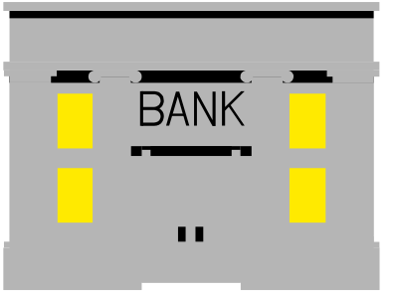
Installment Notes Payable
Regular Payments of Principal plus Interest
Company
Lender
Regular Payments of Principal plus Interest
Payments can either be:
equal principal payments
equal payments.
Note Date
Note Maturity Date
Notes:
2
2

Slide 25
Installment Notes Payable Equal Principal Payments
Annual total payments decrease.
$16,000
$14,000
$12,000
$10,000
Interest
$8,000
Principal
$6,000
$4,000
$2,000
$0
$-
Year 1
Year 2
Year 3
Year 4
Year 5
Year 6
The principal payments are $10,000 each year.
Interest expense decreases each year.

Slide 26
Installment Notes Payable Equal Payments
Annual total payments are constant.
$14,000
$12,000
$10,000
$8,000
Interest
$6,000
Principal
$4,000
$2,000
$0
$-
Year 1
Year 2
Year 3
Year 4
Year 5
Year 6
The principal payments increase each year. Interest expense decreases each year.

Slide 27
Mortgage Notes
A legal agreement helps protect the lender if the borrower fails to make the required payments.
Upon default, the lender has the right to be paid out of the cash proceeds from the sale of the borrower’s assets specifically identified in the mortgage contract.

Slide 28
Decision Analysis

Slide 29
Pledged Assets to Secured Liabilities
Pledged Assets to Secured Liabilities
Book Value of Pledged Assets
Book Value of Secured Liabilities
=
This ratio helps creditors determine whether the pledged assets of a debtor provide adequate security for secured debt obligations.

